Slide 1
Maximum Likelihood & Branch Swapping
Best Tree!
Replicates!

Slide 2
Key Issues of Phylogenetics
PARSIMONY
DISTANCE METHODS (neighbour-joining, minimum evolution)
MAXIMUM LIKELIHOOD – branch swapping, find the best tree
– how many branch swapping replicates?
BAYESIAN INFERENCE – MC³, sample the cloud of best trees

Slide 3
Metropolis-Coupled Markov Chain Monte Carlo

Slide 4
Metropolis-Coupled Markov Chain Monte Carlo

Slide 5
Metropolis-Coupled Markov Chain Monte Carlo

Slide 6
Metropolis-Coupled Markov Chain Monte Carlo

Slide 7
Metropolis-Coupled Markov Chain Monte Carlo
Monte Carlo

Slide 8
Metropolis-Coupled Markov Chain Monte Carlo
Markov Chain
Monte Carlo

Slide 9
Metropolis-Coupled Markov Chain Monte Carlo
Markov Chain
Monte Carlo
Cloud of best trees

Slide 10
Metropolis-Coupled Markov Chain Monte Carlo
Markov Chain
Monte Carlo
Multiple Chains!
Metropolis-Coupled
Cloud of best trees

Slide 11
Metropolis-Coupled Markov Chain Monte Carlo
Markov Chain
Remove burn-in
Monte Carlo
Multiple Chains!
Metropolis-Coupled
Cloud of best trees

Slide 12
9900 sampled trees….

Slide 13
9900 sampled trees….

Slide 14
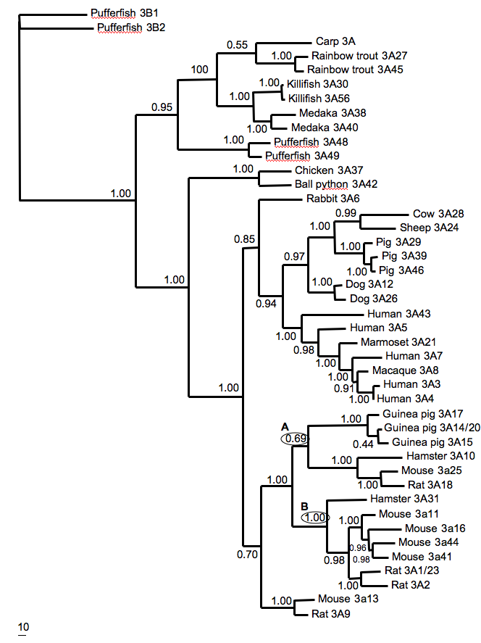
9900 sampled trees….

Slide 15
9900 sampled trees….

Slide 16
Key Issues of Phylogenetics
PARSIMONY
DISTANCE METHODS (neighbour-joining, minimum evolution)
MAXIMUM LIKELIHOOD – branch swapping, find the best tree
– how many branch swapping replicates?
BAYESIAN INFERENCE – MC³, sample the cloud of best trees
– how many trees should be sampled?
– convergence?

Slide 17
Key Issues of Phylogenetics
PARSIMONY
DISTANCE METHODS (neighbour-joining, minimum evolution)
MAXIMUM LIKELIHOOD – branch swapping, find the best tree
– how many branch swapping replicates?
– bootstrapping
BAYESIAN INFERENCE – MC³, sample the cloud of best trees
– how many trees should be sampled?
– convergence?

